Slide 1
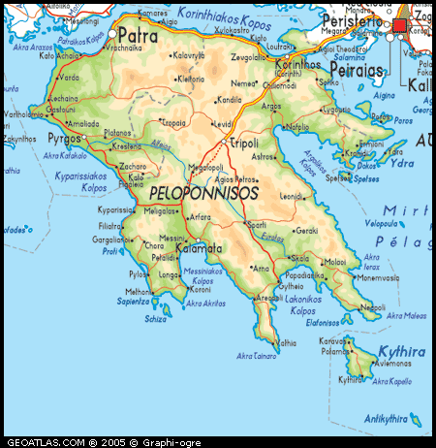
Ancient Korinthos
Epidauros
Ancient Olympia
Mistra
Diros Caves

Slide 2
ANCIENT CORINTH
ΦΥΛΛΟ ΕΡΓΑΣΙΑΣ (group 1)
The Temple of Apollo was built/ columns=
Ancient Agora/ shape/columns=
Odeon was built=
Theatre was built=
Theatre/seats=

Slide 3
ΦΥΛΛΟ ΕΡΓΑΣΙΑΣ (group 2)
The Auditorium was divided =
The circular orchestra/description=
The stage building of the theatre consisted of=
East and west of the 2 backstages there were=

Slide 4
CAVES OF DIROS
ΦΥΛΛΟ ΕΡΓΑΣΙΑΣ (group 3)
It is located=
How many caves=
River length=
Total length of Cave of Diros to date=

Slide 5
ANCIENT OLYMPIA
ΦΥΛΛΟ ΕΡΓΑΣΙΑΣ (group 4)
Highlights=
Dedicated to=
The first recorded athletic event/When/How often=
Last Olympic games/When/What=
2 famous monuments of work of Art=

Slide 6
MYSTRAS
ΦΥΛΛΟ ΕΡΓΑΣΙΑΣ (group 5)
Fortress was built/ When/ by whom=
It served as=
In 1262/What=
In 1460/What=
After 1834/What=

