Slide 1
Winter, Winter how much we love you!

Slide 2
JANUARY
This month was really lovely! Quite mild temperatures, quite good weather. We are telling the truth, see for yourselves! Look at the chart which follows!

Slide 3
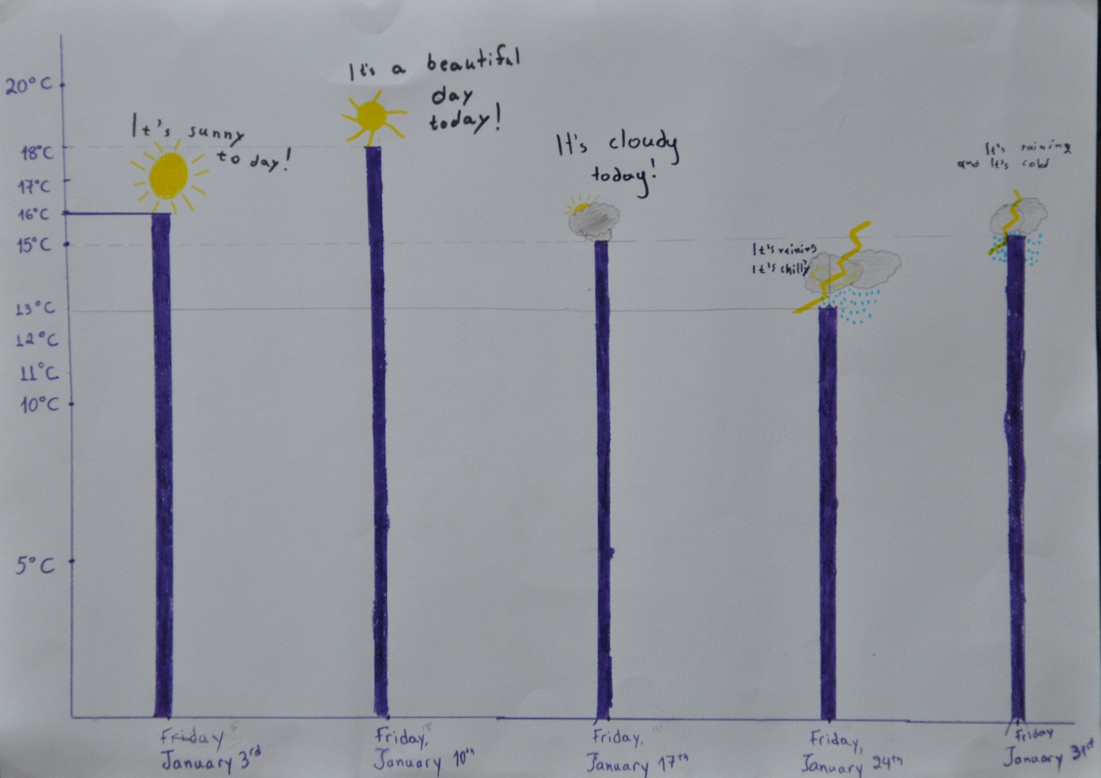
Our temperature chart

Slide 4
Winter plants which grow in Greece
CAN YOU SMELL THEM?

Slide 5
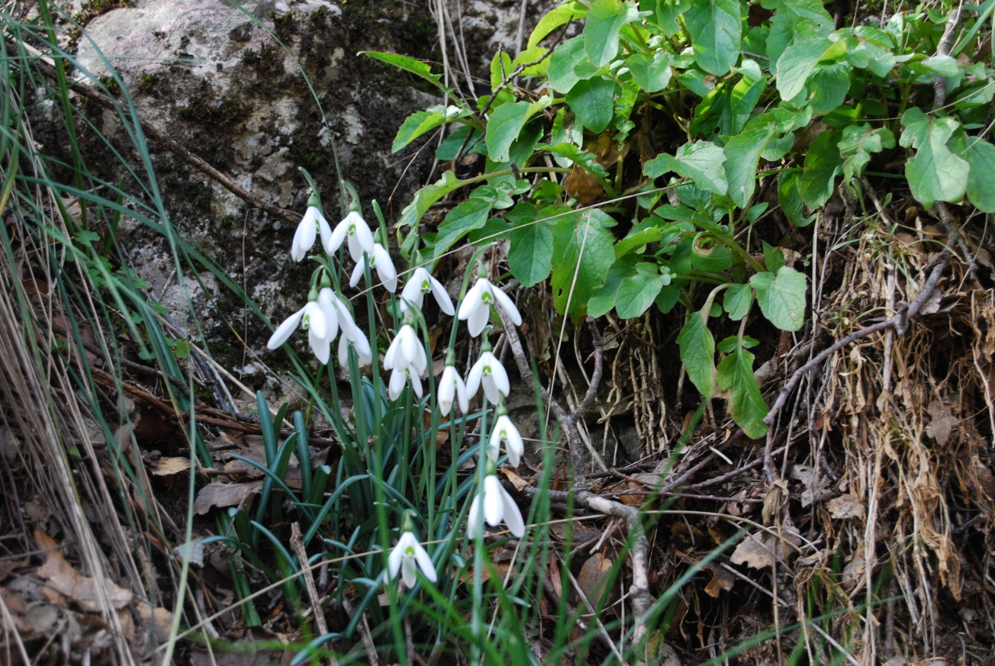
:
Galanthus Nivalis

Slide 6
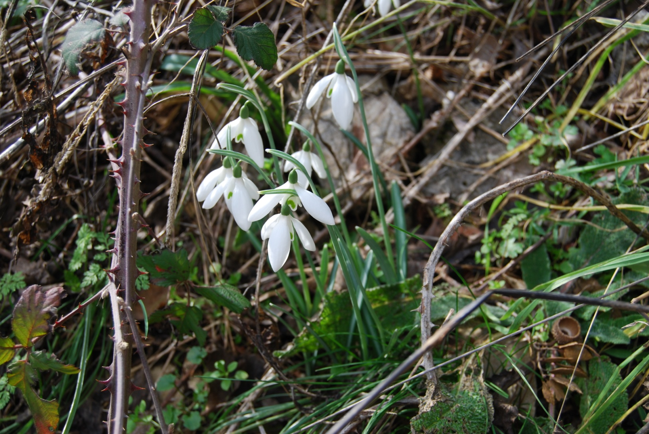
Galanthus Nivalis

Slide 7
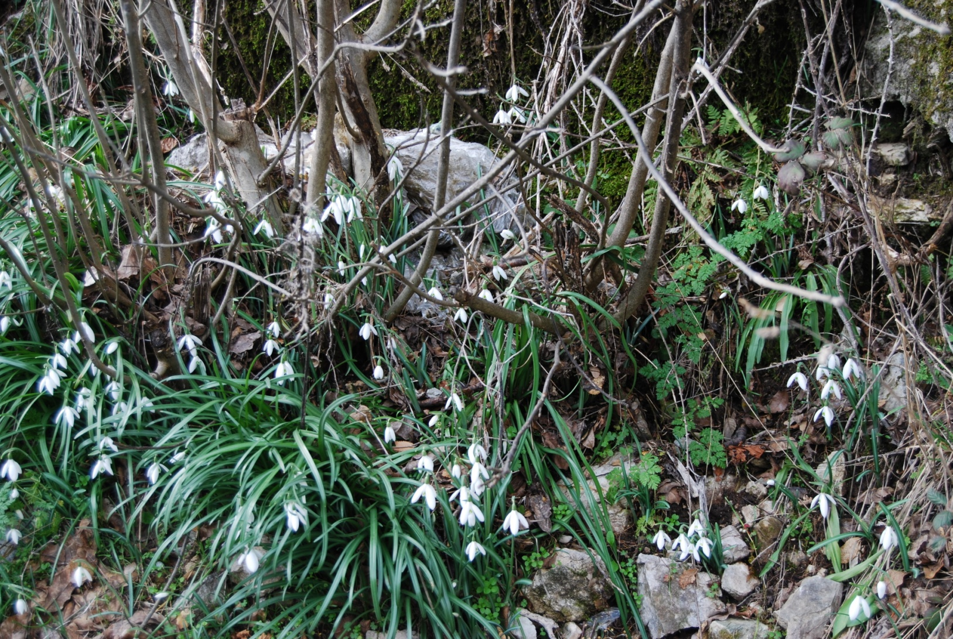
Galanthus Nivalis

Slide 8
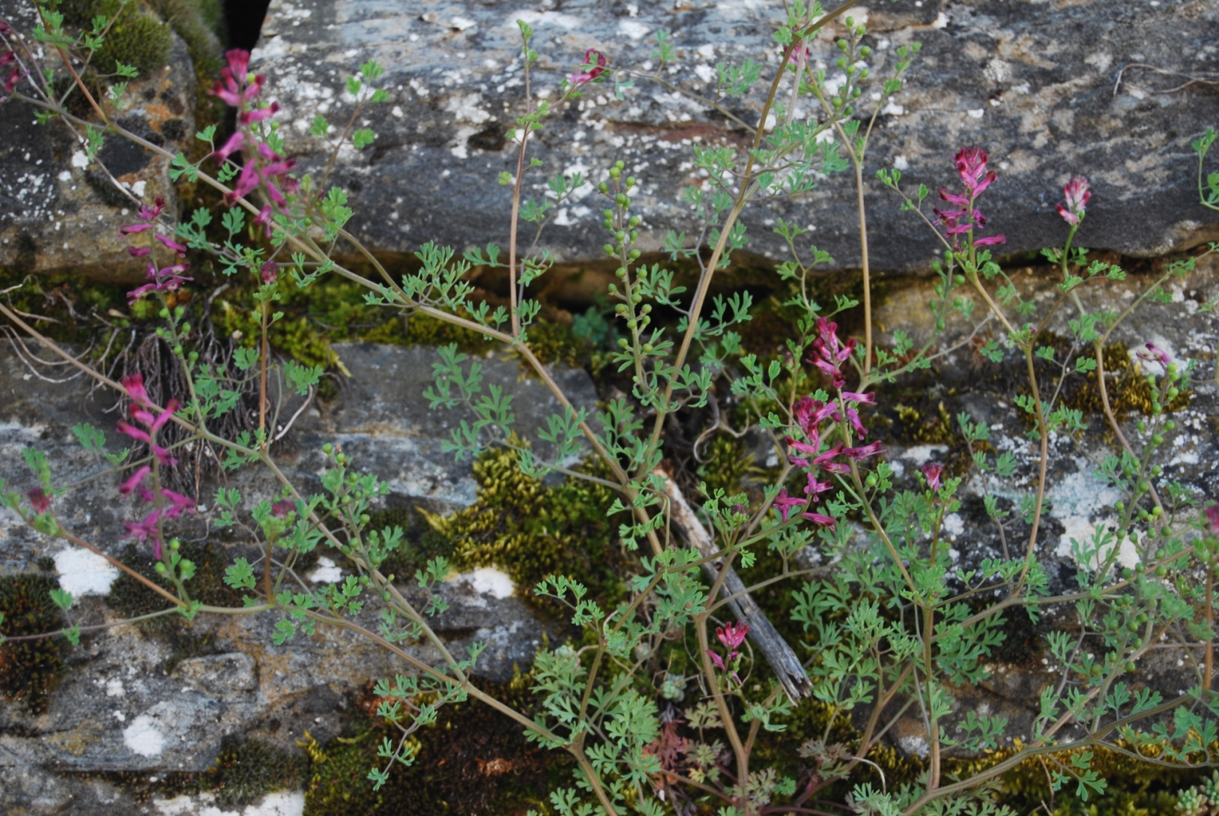
Fumaria Officinalis

Slide 9
AND NOW OUR POEMS!
WINTER
(Dimitra & Sophia)
Winter is here
it is New Year
What are we waiting for?
Wow it is winter
it is cold!
Bring your jacket
and your umbrella, too
because it is rainy
and cold, too!

Slide 10
(Angelo, Nick, Peter)
In winter we make a snowman
and we go skiing
In winter we make Christmas trees
and go to the mountains
It's rainy and cloudy
It's cold and windy
It's snowy
Oh my goodness!
What lousy weather!

Slide 11
(Angelo)
Winter, winter
it's so good!
We make snowmen
and we have fun!
Winter, winter
It's so cold!
The school is open
but we say "NO"!

Slide 12
(Joanna)
We play with the snow
we make snowmen
we go skiing
we can't swim!
We can't eat ice-cream!
I like winter
we have the carnival
I like winter
we have Christmas!
It's snowing
it's raining
It's chilly
It's cold! I like winter!

Slide 13
(Evelina)
Winter is cool!
In winter
we go to school!
In winter
it is rainy and cold
in winter
we go skiing
In winter
we make snowmen
and we have lots of fun!

Slide 14
(Spyros)
In the winter we go skiing
and make snowmen
but we don't go to the sea
or eat ice cream!
But we love winter
'cause Santa Claus is coming!

Slide 15
(Nicol & Argy)
It's snowy in winter
in winter it's snowy!
We go skiing
We go up in the mountain
and we make a snowman!
Winter, winter,
Yes, we love winter!
No Summer,
No Autumn,
No Spring,
Only Winter!

Slide 16
(Anastasis & Leonidas)
In winter it snows
it rains and it's cloudy
the temperature is so low!
In the winter we have
the Christmas Holidays!
The Children are happy
and they make snowmen!
In the winter it's the carnival
we wear fancy costumes
and dance everyday!

Slide 17
THE END
By the 4th grade-pupils of the Model experimental school of Patras

