Slide 1
Rules of Past Simple & Past Continuous
Hello students today , we are going to teach you the rules of past simple and the rules of past continuous.

Slide 2
PAST SIMPLE Theory
Use the Simple Past to express the idea that an action started and finished at a specific time in the past. Sometimes, the speaker may not actually mention the specific time, but they do have one specific time in mind.

Slide 3
Examples:
I saw a movie yesterday.
I didn't see a play yesterday.
Last year, I traveled to Japan.
Last year, I didn't travel to Korea.
Did you have dinner last night?
She washed her car.
He didn't wash his car.

Slide 4
PAST CONTINUOUS Theory
Use the Past Continuous to indicate that a longer action in the past was interrupted. The interruption is usually a shorter action in the Simple Past. Remember this can be a real interruption or just an interruption in time.

Slide 5
Examples:
I was watching TV when she called.
When the phone rang, she was writing a letter.
While we were having the picnic, it started to rain.
What were you doing when the earthquake started?
I was listening to my iPod, so I didn't hear the fire alarm.
You were not listening to me when I told you to turn the oven off.
While John was sleeping last night, someone stole his car.
Sammy was waiting for us when we got off the plane.
While I was writing the email, the computer suddenly went off.
A: What were you doing when you broke your leg? B: I was snowboarding.

Slide 6
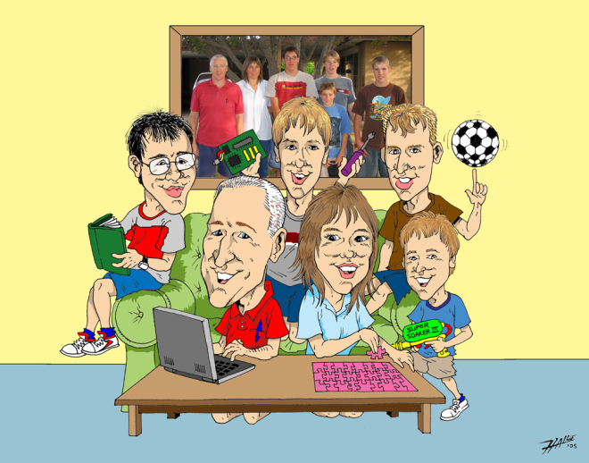
Consolidation Exercises
Look at this picture and write what this family
Was doing
Yesterday
At around
9
O’clock.
_____________________________________________________________________________________________________________________________

Slide 7
Thank you for watching our presentation and we hope you have learned the differences between Past Simple & Past Continuous.
George S.
Michael K.

