Slide 1
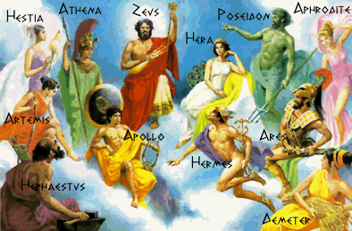
the Gods of Olympus

Slide 2
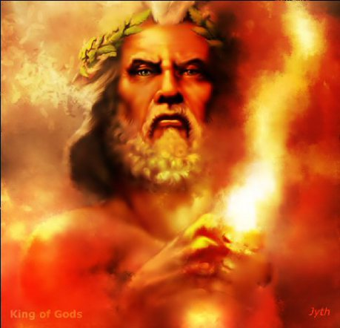
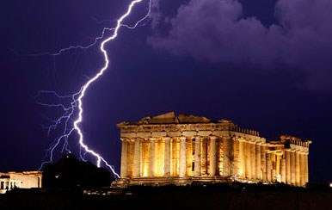
Zeus is the king of Olympus
Zeus is the father of gods, and also Zeus is the god of lightning.

Slide 3
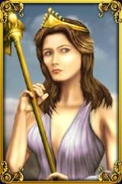
.
Hera
Sister, and husband of Zeus.
Also marriage protector.

Slide 4
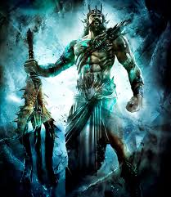
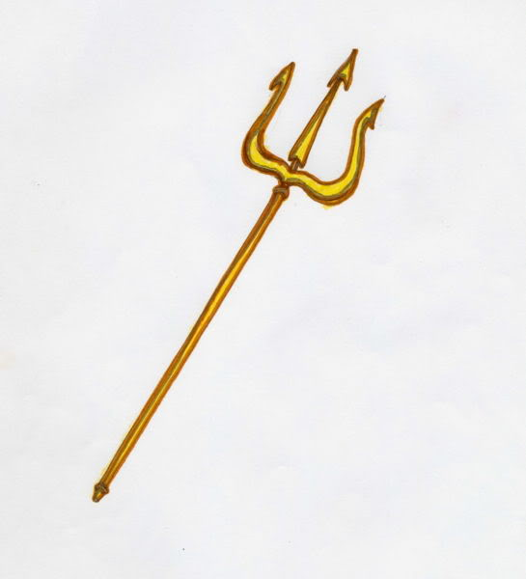
Poseidon
Poseidon is the king of the seas.

Slide 5
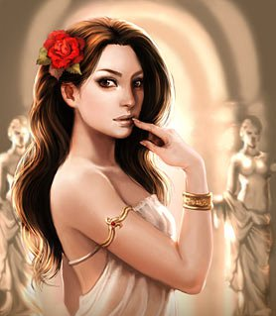
VENUS
Venus is the goddess of love and beauty.

Slide 6
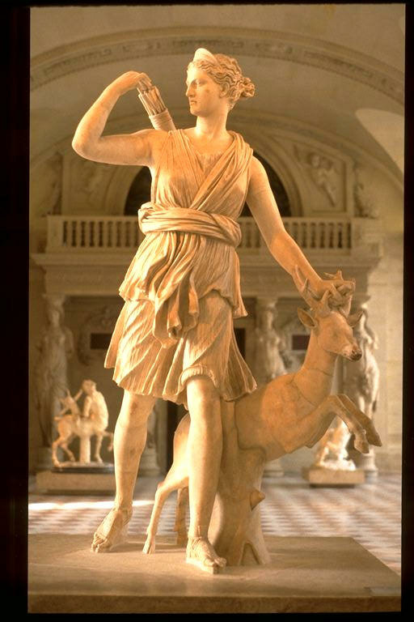
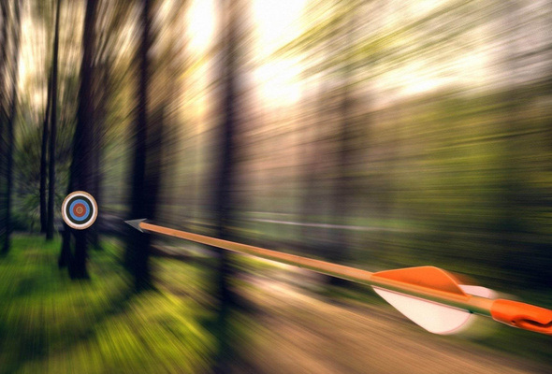
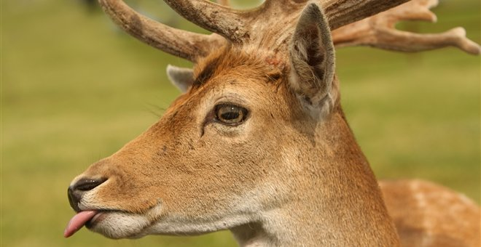
Artemis
Artemis is the goddess of hunting, and nature protector as well.

Slide 7
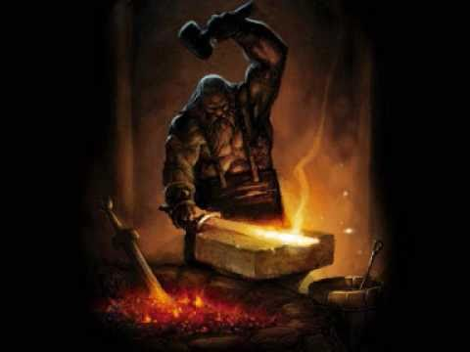
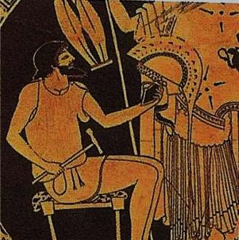
Hephaestus
Hephaestus is the god of fire
and technology.

Slide 8
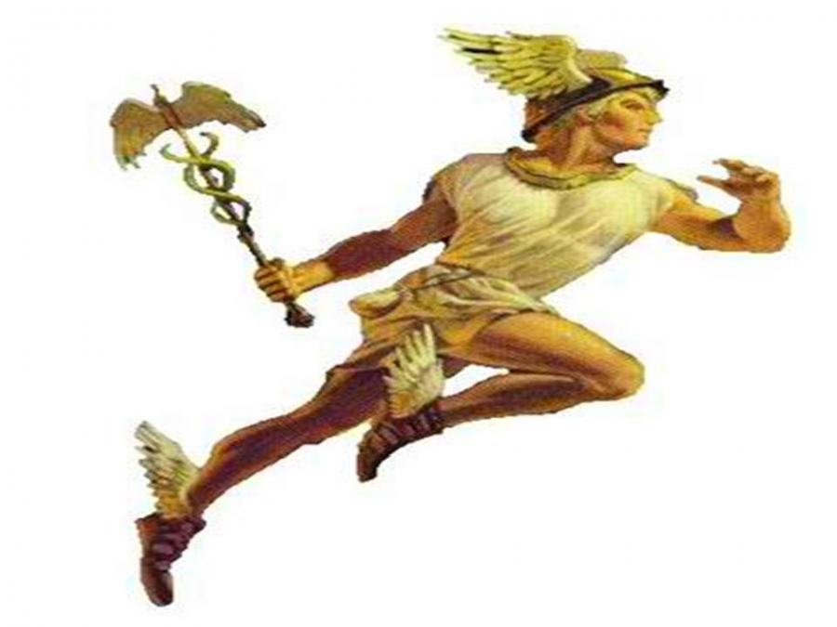
Hermes
Hermes is the messenger of gods also commercial protector.

Slide 9
Athena
Goddess of wisdom, and arts.

Slide 10
Dimitra
Goddess of agriculture

Slide 11
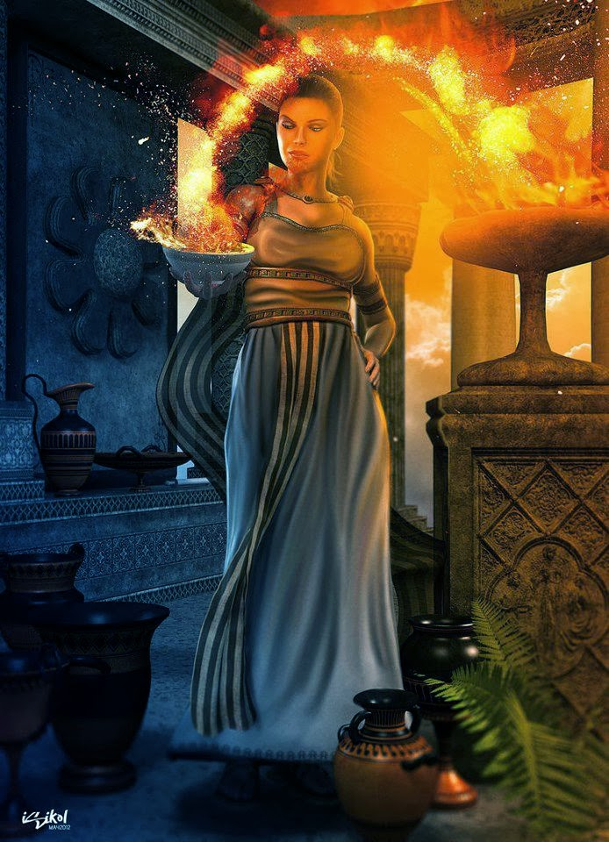
Hestia
Family happiness protector.

Slide 12
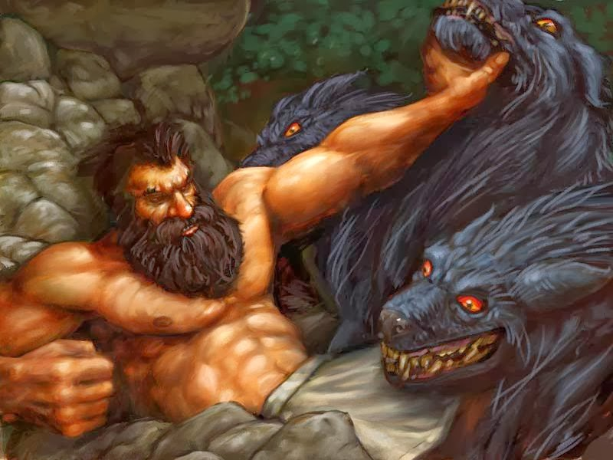
Pluto
God of underworld Kingdom.

Slide 13
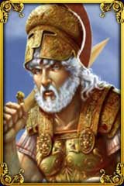
Ares
God of war and martial arts.

Slide 14
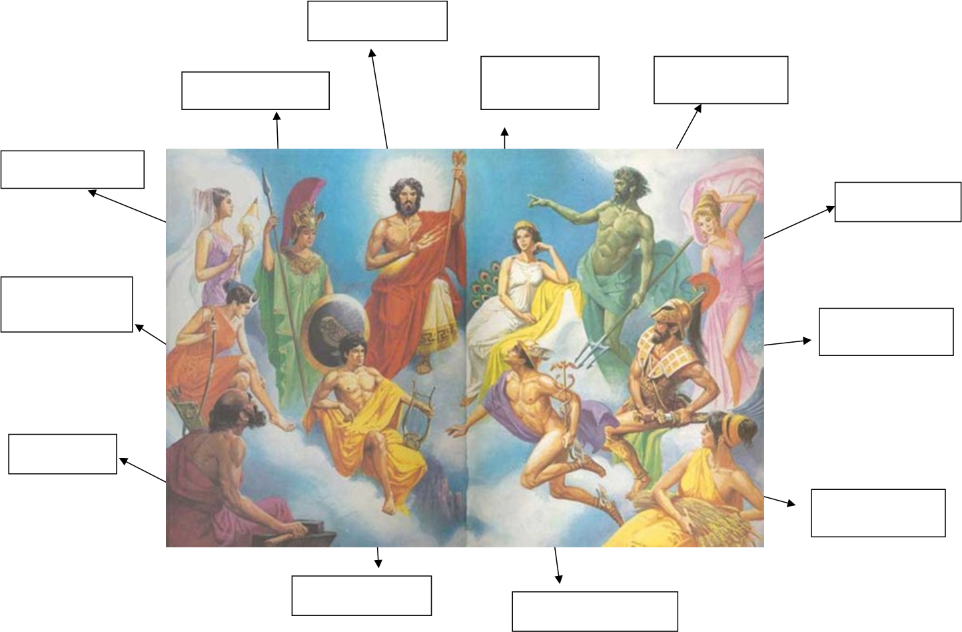

Slide 15
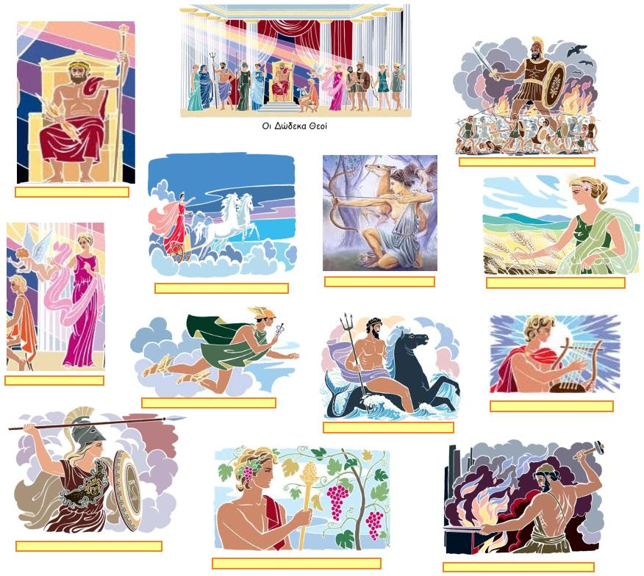

Slide 16
VIDEO: “THE OLYMPIAN GODS”

Slide 17
Thank you for your attention
RAFAEL-MAXIMUS

