Slide 1
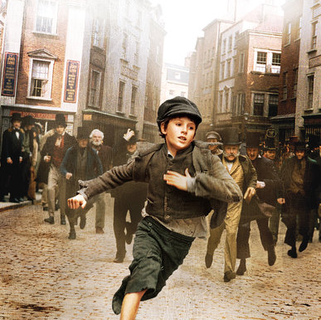
Oliver Twist

Slide 2
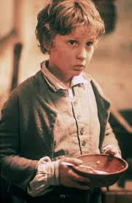
Main plot
Oliver is a poor and orphan child who lives in the suburbs of London. When he becomes 10 years old Mr. Bubble takes him to the asylum. There the living conditions where extremely bad.

Slide 3
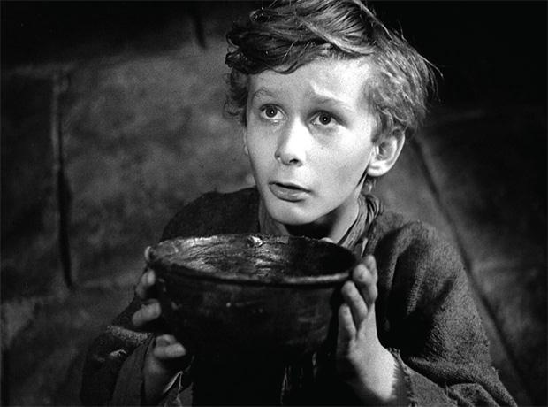
Imagine that one day when Oliver asked for some more food the asylum chef hit him and hurt his head!!!

Slide 4
VIDEO

Slide 5
My favorite character
My favorite character is Oliver Twist because he fights to survive. He is such a good boy and deserves a better, happier life.

Slide 6
Why I like this book
I like this book because it’s full of action and suspense. It’s not so thick… only 163 pages. It can help you use your imagination, by creating lots of pictures in your mind! So do not stick to the video images… Read the book and “travel” with your fertile imagination!

Slide 7
Author: the English novelist Charles Dickens.
Publish: published in 1838

Slide 8
THANKS FOR WATCHING!!!

