Slide 1
Odysseus & Polephemus
Ulysses

Slide 2
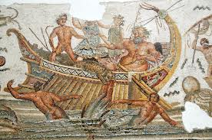
ODUSSEUS’ SHIP

Slide 3
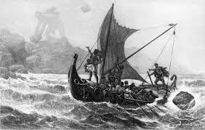
ODYSSEUS’ SHIP

Slide 4
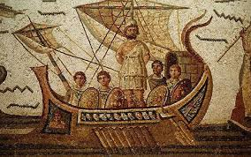
ODYSSEUS’ SHIP

Slide 5
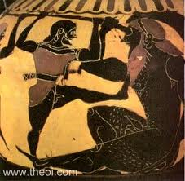
ODYSSEUS & POLYPHEMUS

Slide 6
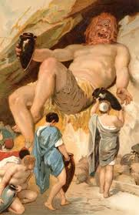
ODYSSEUS & POLYPHEMUS

Slide 7
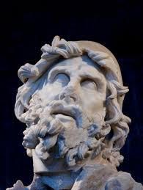
ODYSSEUS or ULYSSES

Slide 8
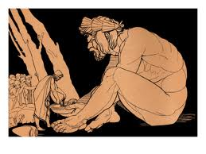
ULYSSES, HIS COMPANIONS & THE CYCLOPS

Slide 9
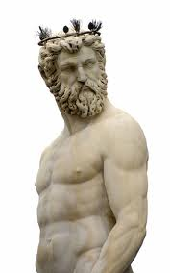
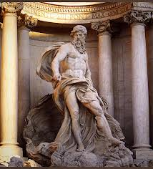
POSEIDON (THE GOD OF THE SEA, POLYPHEMUS’ FATHER)

Slide 10
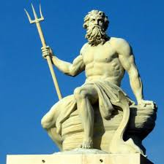
POSEIDON (THE GOD OF THE SEA, POLYPHEMUS’ FATHER)

Slide 11
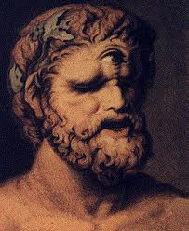
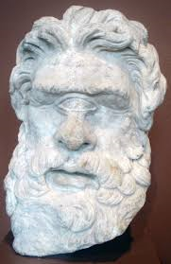
POLYPHEMUS

Slide 12
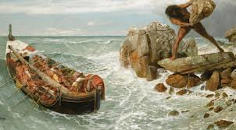
POLYPHEMUS THROWING STONES AT ULESSES’ SHIP

Slide 13
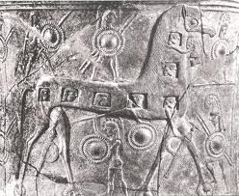
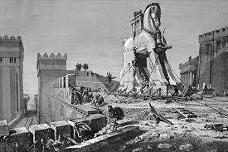
THE WOODEN HORSE (ODYSSEUS’ CUNNING TRICK)

