Slide 1
The ancient Roman Odeon
HELLO!!! I AM LYDI AND I AM KATHERINE.
WE ARE GOING TO PRESENT YOU THE ANCIENT ROMAN ODEON
Just click “next” for some information!

Slide 2
INFORMATION…
To the west of the Acropolis, in the Upper Town, is the Roman Odeon of Patras erected earlier than the Conservatory of Athens (Herodium, 160 AD).
Pausanias who visited Patras around 170 AD writes, “It has the nicest decor I've seen. The exception is, of course, that of the Conservatory of Athens." According to Pausanias, in the Conservatory, which was contiguous to the ancient Agora, there was a statue of God Apollo, made ​​from ‘spoils of war’ against the Gauls (279 BC) when Patras had helped the Aetolians.

Slide 3
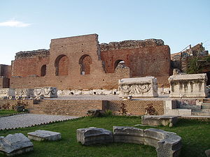
And now……some pictures!
This is a picture of the front side of the Odeon.

