Slide 1
Rules for “I like”
We put (ing) after like
e.g. I like playing football.

Slide 2
AFFIRMATIVE
In the affirmative we put -ing.
E.g. I like listening to music.

Slide 3
INTERROGATIVE (?)
In the question we put DO
e. g. Do you like playing volleyball ?

Slide 4
NEGATIVE
In the negative we put DO NOT (don’t)/ DOES NOT (doesn’t)
e.g.I don’t like eating tomatoes.
She doesn’t like collecting tree leaves.

Slide 5
Examples
All the children like eating vegetables

Slide 6
I like looking at fish!
LIKE + ING
I like looking at fish

Slide 7
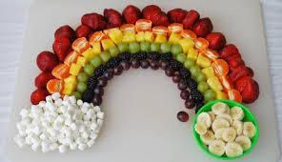
I like eating fruit. Do you?
Do you like eating fruit?
I like eating fruit

Slide 8
I like smelling flowers!
Do you like smelling flowers?
I like smelling flowers

Slide 9
ANSWERS
Yes, I do!
No, I don’t.

Slide 10
ANSWERS
Yes, she does!
No, she doesn’t.

Slide 11
By Angelina
THANKS FOR YOUR ATTENTION!

