Slide 1
Ipsila Alonia
is the most famous area in Patras
(BY LEONIDAS, GRADE 5TH, E1)

Slide 2
Interesting sights in the area is the Sundial, which was placed in the square in 1953, and the Gkolfinopoylou Mansion.

Slide 3
Psilalonia, is an area in the city centre of Patras. The Psilalonia square, located in this neighbourhood,is one of the largest and most beautiful squares in Greece.

Slide 4
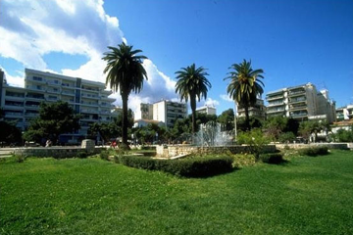

Slide 5
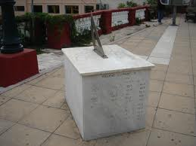
Notes:
SUNDIAL

Slide 6
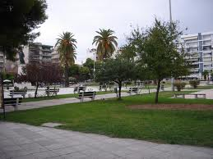

Slide 7
