Slide 1
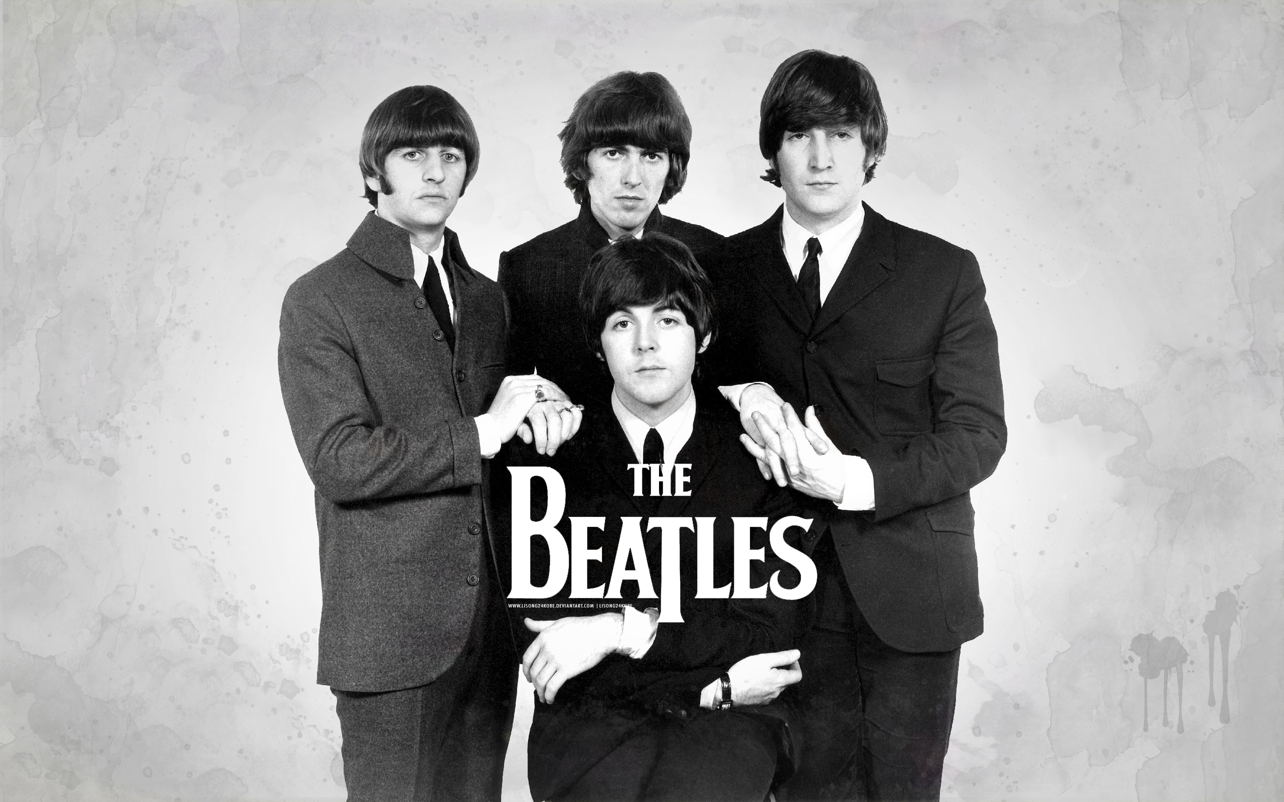

Slide 2
A few things about Beatles
John Lennon met Paul McCartney when they were both performing in Skiffle Groups, which were homespun bands that played a combination of folk, rock and jazz. John was in a group called The Quarrymen. Paul introduced John to George Harrison. John, Paul and George, with the addition of Johns Friend from art college.

Slide 3
johnLennon
John Ono Lennon, ( 9 October 1940 -8 December 1980) was an English rock musician, singer, songwriter, artist, and peace activist who gained worldwide fame as one of the founders and members of The Beatles.
In his solo career, Lennon wrote and recorded songs such as Give Peace a Chance and Imagine.
He believed that:
“Christianity will go.. It will vanish and shrink. I needn't argue with that. I'm right and I will be proved right. Were more popular than Jesus now. I don't know which will go first, rock and roll or Christianity. Jesus was all right, but his disciples were thick and ordinary. Its them twisting it that ruins it for me.”

Slide 4
paulMcCartney
Paul McCartney, ( born on 18 June 1942) is an English singer, songwriter, composer, multi-instrumentalist, poet, painter, record producer, film producer, and animal rights activist. He gained worldwide fame as one of the founders and members of The Beatles. McCartney and John Lennon formed one of the most influential and successful songwriting partnerships and wrote some of the most popular music in rock and roll history.
He believed that:
“We would be really big in Liverpool.”

Slide 5
georgeHarrison
George Harrison, (25 February 1943 to 29 November 2001), was an award winning English rock guitarist, singer, songwriter, author and sitarist best known as the lead guitarist of The Beatles. Following the bands breakup, Harrison had a successful career as a solo artist and later as part of the Traveling Wilburys super group where he was known as both Nelson Wilbury and Spike Wilbury.
He believed that:
“When you’ve seen beyond yourself, then you may find, peace of mind is waiting there.”

Slide 6
ringoStarr
Richard Starkey, (born 7 July 1940) better known by his stage name Ringo Starr, is an Academy Award winning English musician, singer, songwriter and actor, best known as the drummer for The Beatles. He was the oldest member of the band.
He believed that:
“Drumming is his middle name.”

Slide 7
YESTERDAY

Slide 8
Thank you…
georgeStergiopoulos

