Slide 1
CITY NATURE
PATRAS

Slide 2
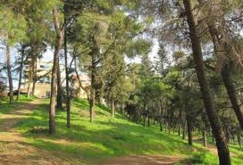
Dasillio-grove

Slide 3
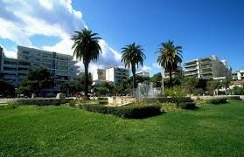
City park

Slide 4
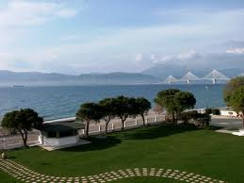
Rion beach

Slide 5
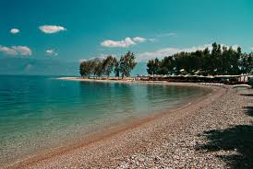
Saint Vasilios beach

Slide 6
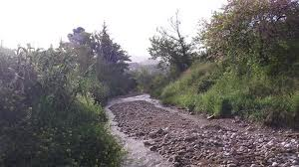
Meilichos River

Slide 7
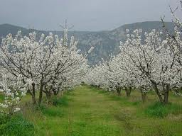
Cherry trees in bloom on the outskirts of the city

Slide 8
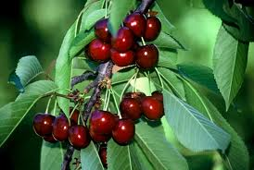
Local produce: cherries

Slide 9
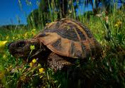
Tortoise in our fields

Slide 10
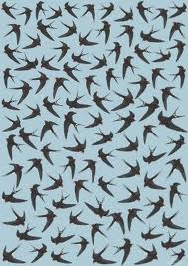
Patras sky is full of swallows

Slide 11
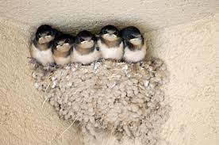
You can see swallow nests in every single balcony of the city houses & buildings this time of year

Slide 12
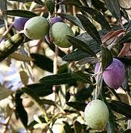
OLIVES & OLIVE OIL OUR LOCAL & NATIONAL PRODUCT

Slide 13
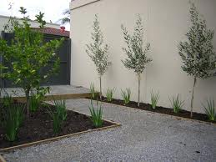
OLIVE TREES

Slide 14
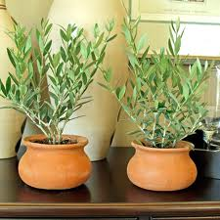
OLIVE TREES you can see olive trees everywhere even in small flower pots

Slide 15
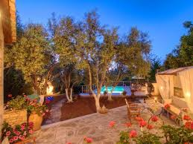
OLIVE TREES IN GARDENS

Slide 16
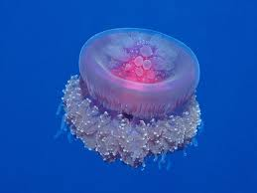
JELLY FISH

Slide 17
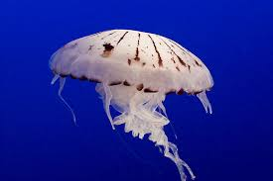
Unfortunately in August you can meet this beautiful but dangerous kind of fish in our sea

