Slide 1
How we celebrate carnival at school
Savvas
Kostas
ST2 -6th grade of model primary Experimental school of Patras

Slide 2
PATRAS CARNIVAL
Almost in every school in Patras we prepare a party to celebrate carnival and have fun! Our teacher decides which day we will
do the carnival party more usually during the last week before the final Sunday parade. Then we decide which kids are going to bring the drinks, the chips and the CDs of course .We wear fancy dress costumes or masks and wigs. All teachers and students laugh , sing and dance. Every year we look forward to this special school carnival party!

Slide 3
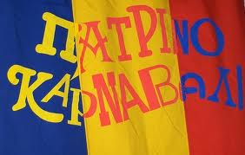
Patras Carnival

Slide 4
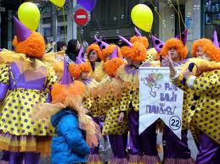
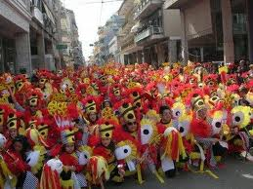
CARNIVAL GROUPS

