Slide 1
Autumn plants growing in Greek areas
…and their therapeutic/curative properties

Slide 2
Cyclamen graecum (cyclamen the Greek)

Slide 3
Cyclamen the Greek

Slide 4
Healing properties
It is used for pharmaceutical reasons. Research has shown that it has therapeutic properties. In Homeopathy the tincture from its nodule is used against arthritis, rheumatism and migraines.
But we have to be careful, because “cyclamine”- even in small dosages- can be really toxic!

Slide 5
Crocus Iaevigatus Bory

Slide 6
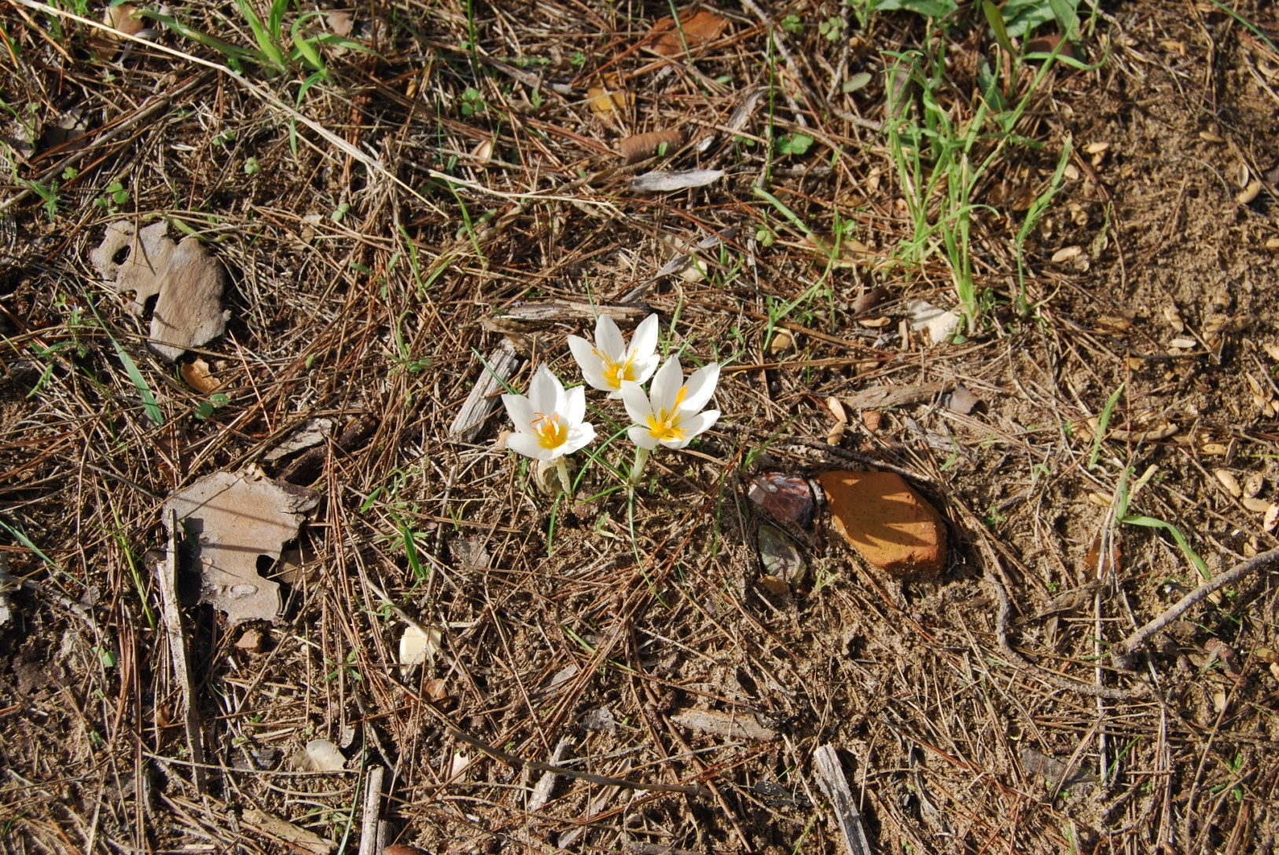
Crocus

Slide 7
Crocus therapeutic properties
Its stigmas are regarded as appetizing , soothing and sweet-smelling
They have anti-cancer and antic-oxidization properties
Crocus extracts are considered to fight cancer, yet, in large dosages, even some gram, can be very toxic.

Slide 8
Colchicum graecum

Slide 9
Colchicum graecum

Slide 10
Therapeutic properties
It is used in Homeopathy, and it is considered a classic special medicine against rheumatism. It’s substance called “Colchikene”, has been used against cancer and leukemia.
However, all the parts of the plant are extremely poisonous and need specialized processing. By no means should they be used by people without specialized knowledge. Doctors/chemists are only qualified to know.

