Slide 1
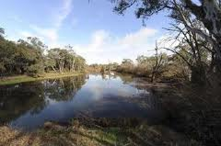
Australia’s rivers and mountains

Slide 2
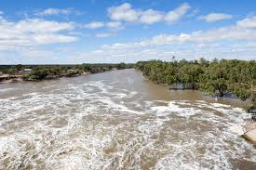
Rivers
Australian rivers are mostly situated near the coast. The eastern part of the country is home to the longest and largest Australian rivers. These rivers rise from the mountains and traverse the forests, wetlands and towns.

Slide 3
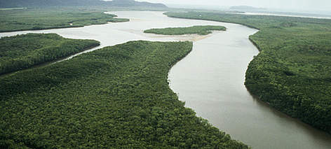
The longest river
The Murray River is the country’s longest river, running at 2,508 kilometers from the Alps, down to the west side of the country’s highest mountains and crossing the inland plains, creating the border between Victoria and New South Wales, before finally joining the ocean at Lake Alexandrina.

Slide 4
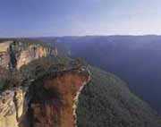
Mountains
The Great Dividing Range
The Blue Mountains, New South Wales. Image courtesy of tourism New South Wales
The Great Dividing Range is one of Australia's most important geographical features. It divides the east coast from the inland and has a major influence on our climate, population spread and settlement patterns, economics and agriculture. It is home to an amazing array of plants and animals that don't exist anywhere else on earth. It is the source of the longest rivers and highest mountains.

Slide 5
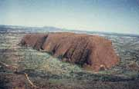
Rocky outcrops
Other rock structures in Australia, like Uluru, Mount Augustus and Bald Rock, have been described as monoliths.

Slide 6
THANKS FOR WATHING
BY FOTIS
AND
STEFANOS

